Slide 1
影像處理、電腦視覺及深度學習概論 (Introduction to Image Processing, Computer Vision and Deep Learning) Homework 1
TA:
Kevin: i1007673219@gmail.com
Office Hour: 19:00~21:00, Mon.
09:00~11:00, Wed.
At CSIE 9F Robotics Lab.

Slide 2
Notice (1/2)
Copying homework is strictly prohibited!! Penalty: Grade will be zero for both persons!!
If the code can’t run, you can come to our Lab within one week and show that your programming can work. Otherwise you will get zero!!
Due date => 2019/11/07 (Thu.) 23:59:59
No delay. If you submit homework after deadline, you will get 0.
Upload to => 140.116.154.1 -> Upload/Homework/OpenCv_Hw1
User ID: opencvdl2019 Password: opencvdl2019
Format
Filename: Hw1_StudentID_Name_Version.rar
Ex: Hw1_F71234567_林小明_v1.rar
If you want to update your file, you should update your version to be v2, ex: Hw1_F71234567_林小明_v2.rar
Content: project folder*( including the pictures ) *note: remove your “Debug” folder to reduce file size
1

Slide 3
Notice (2/2)
C++ (check MFC guide in ftp)
OpenCV 3.3.1 (https://opencv.org/release.html)
Visual Studio 2015 (download from http://www.cc.ncku.edu.tw/download/)
UI framework: MFC
Python
Python 3.7 (https://www.python.org/downloads/)
Tensorflow 2.0 / PyTorch 1.3.0
opencv-contrib-python (3.4.2.17)
Matplotlib 3.1.1
UI framework: pyqt5 (5.11.3)
1

Slide 4
Assignment scoring (Total: 100%)
0. GUI
1. (10%) Image Processing (出題：Shaku)
1.1 Load Image File
1.2 Color Conversion
1.3 Image Flipping
1.4 Blending
2. (10%) Adaptive Threshold (出題：Shaku)
2.1 Global Threshold
2.2 Local Threshold
3. (10%) Image Transformation (出題：YiYuan)
3.1 Rotation, scaling, translation
3.2 Perspective transform
4. (20%) Convolution (出題: Kris)
5. (50%) Training MNIST classifier using LeNet (出題：Charlie)
1

Slide 5
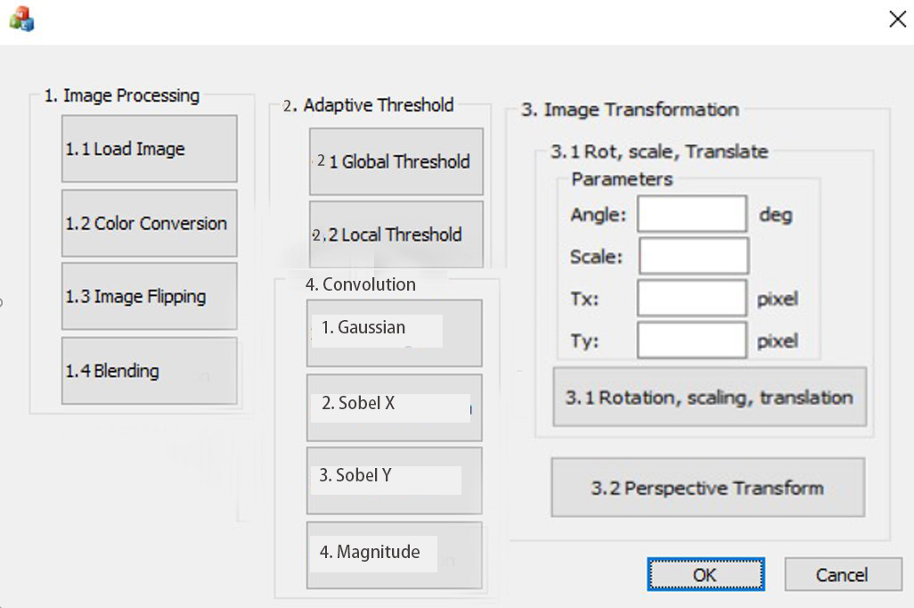
0. GUI
Use MFC to create GUI like following figure.
1

Slide 6
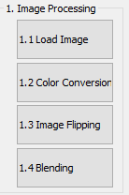
1. Image Processing (出題： Shaku)
1.1 Load Image File
1.2 Color Conversion
1.3 Image Flipping
1.4 Blending
1

Slide 7
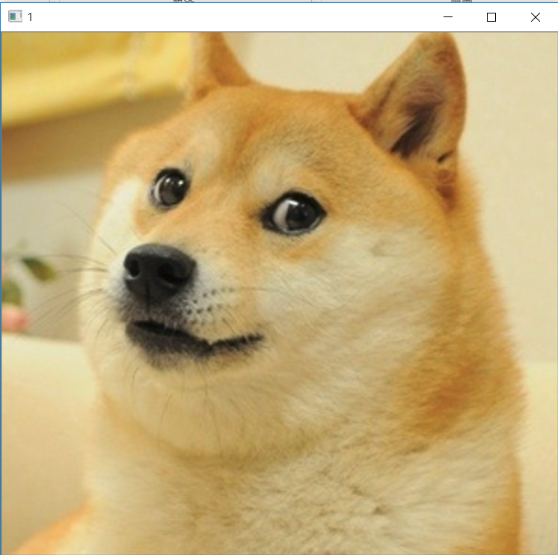
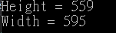
1.1 Load Image File
Given: dog.bmp image
Q: 1) Open a new window to show the image (dog.bmp)
2) Show the height and width of the image in console mode
Hint : Textbook Chapter 2, p. 22~23
1

Slide 8
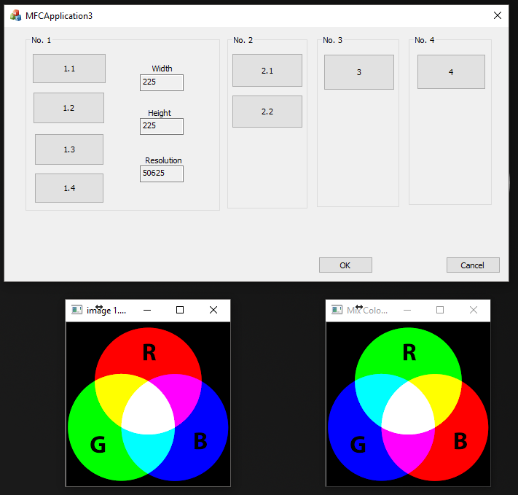
1.2 Color Conversion
Given: a color image, “color.png”
Q: 1) Exchange 3 channels of the image BGR to RBG 2) Open a new window to show the result.
Example：Original BGR value of a pixel P is P(a,b,c), the value of the pixel P will change to P(b,c,a).
Hint: Textbook Chapter 3, p.31 ~ p.44
1

Slide 9
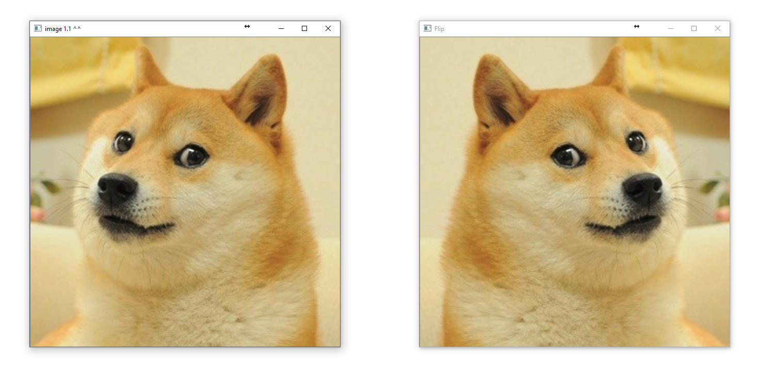
1.3 Image Flipping
Given: an image, dog.bmp
Q: 1) Flip the image (dog.bmp) and open a new window to show the result.
Hint: Textbook Chapter 3, p.31 ~ p.44
1

Slide 10
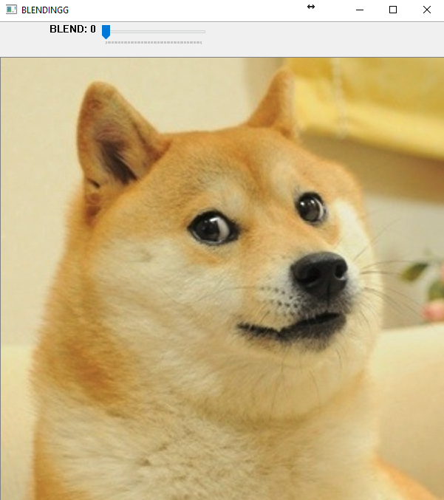

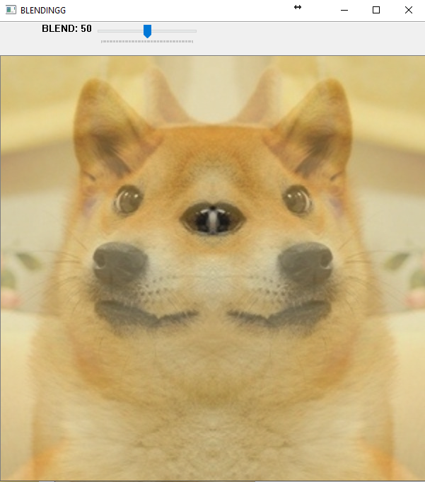
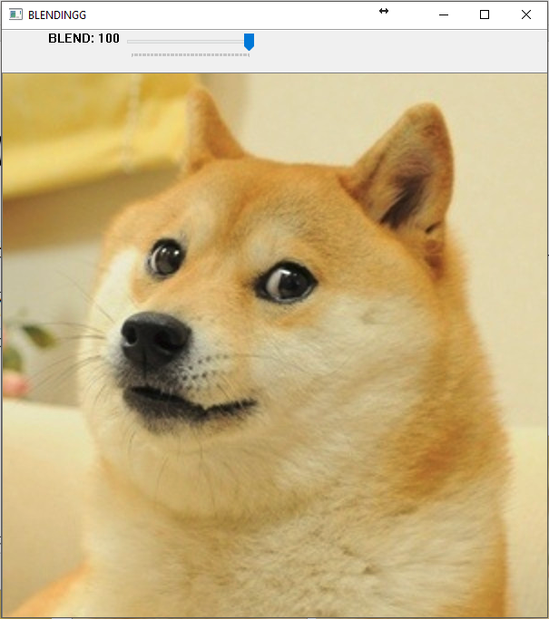
1.4 Blending
Given: 2 images, dog.bmp and the result of 1.3
Q: 1) Combine two images (dog.bmp and the result of 1.3). 2) Use Trackbar to change the weights and show the result in the new window.
Hint:
Textbook Chapter 3, p. 51 ~ 51
createTrackbar(...);
1

Slide 11
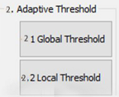
2. Adaptive Threshold (出題: Shaku)
2.1 Global Threshold 2.2 Local Threshold
13

Slide 12
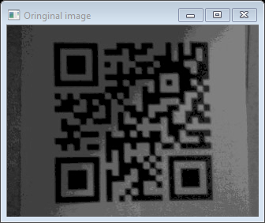
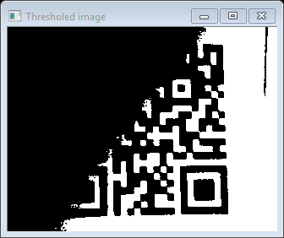
2.1 Global Threshold
Given: a non-uniformly illuminated QR.png
Q: 1) Show original image
2) Show the result after applying global threshold
Hint:
OpenCV Textbook Chapter 5 (p.136~138)
threshold(args) func with threshold value = 80
QR.png
global threshold
14
Notes:
threshold()

Slide 13
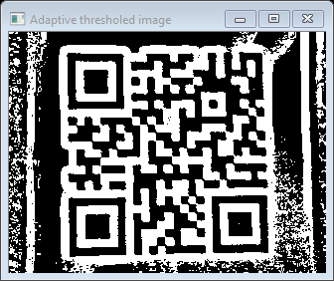
2.2 Local Threshold
Given: a non-uniformly illuminated QR.png
Q: 1) Show original image
2) Show the result after applying local threshold
Hint:
OpenCV Textbook Chapter 5 (p.136~138)
adaptiveThreshold(args) func with blockSize = 19, offset = -1
local threshold
QR.png
14
Notes:
adaptiveThreshold(args)

Slide 14
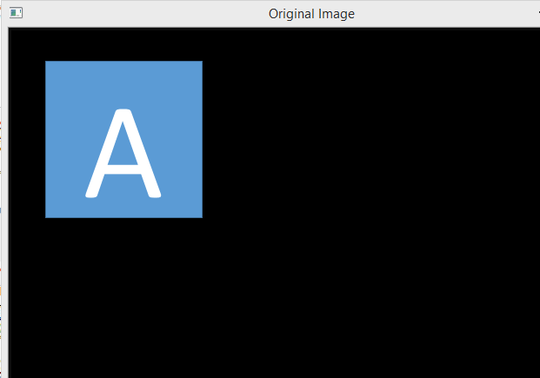
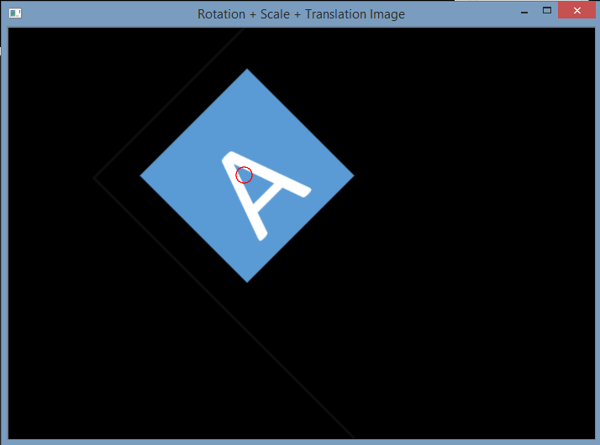
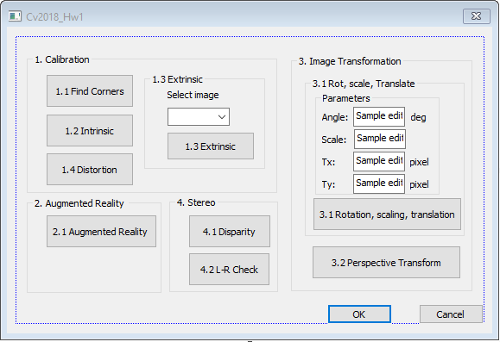
3.1 Transforms: Rotation, Scaling, Translation (出題：YiYuan)
Given: OriginalTransform.png image
Q: 1) Click button “3.1”, OriginalTransform.png should be showed.
2) Please rotate, scale and translate the small squared image (as Figure 3.1) with following parameters (should be entered in the GUI):
(1) Angle = 45⁰ (counter-clockwise)
(2) Scale = 0.8,
(3) Translation with:
x_{new} = x_{old} + 150 pixels = 130 + 150 = 280
y_{new} = y_{old} + 50 pixels = 125 + 50 = 175
Point C (130,125) is center of small square image
Hint :
OpenCV Textbook Chapter 12 (p. 407 ~ p. 412)
warpAffine(…);
EX:
Small square image
C (130,125)
C (280,175)
45⁰
Figure 3.1 Original Image
Figure 3.2 Rotation, Scale and Translation Image
1

Slide 15
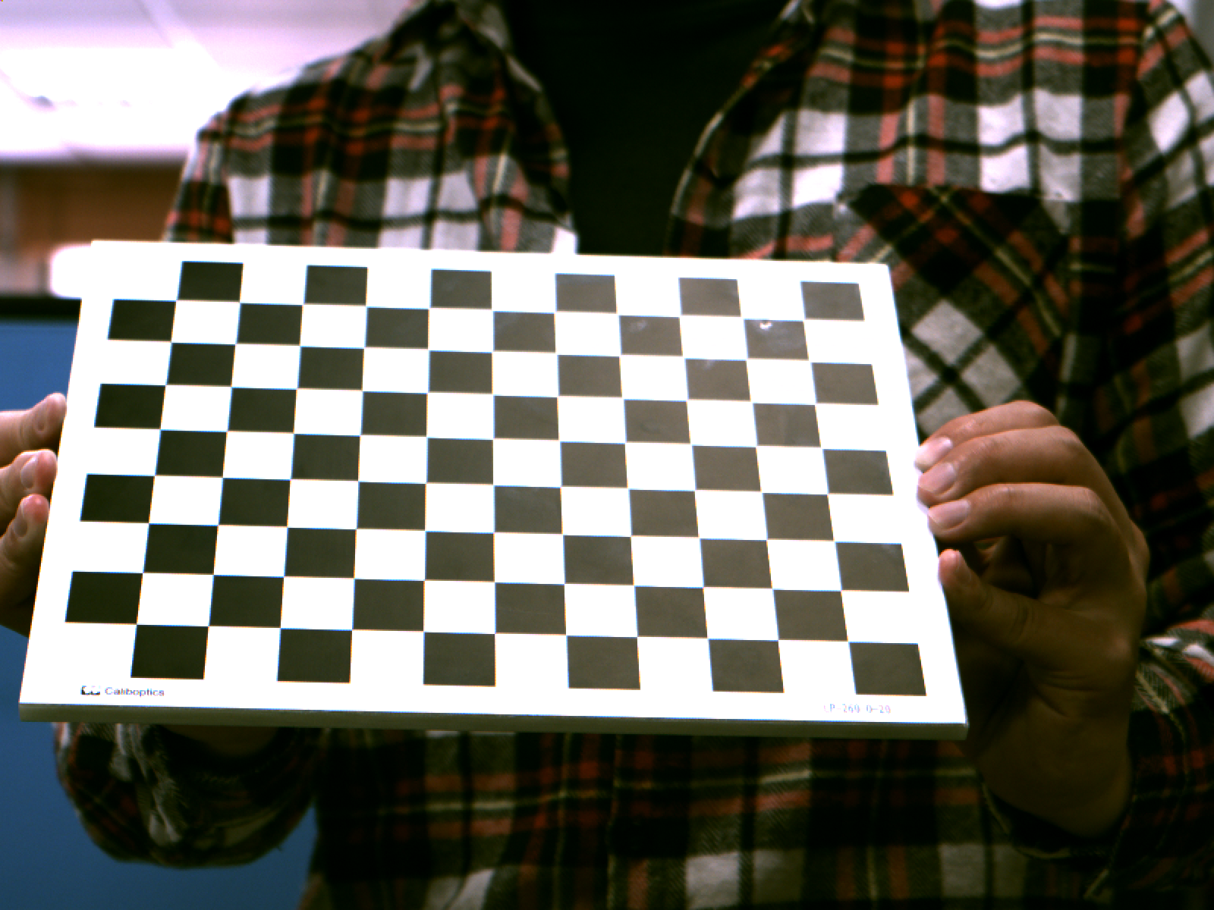
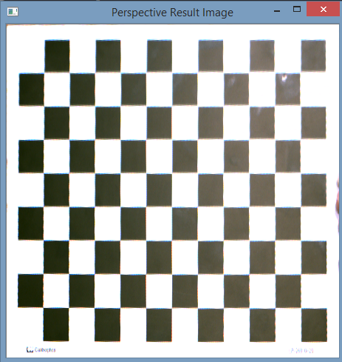
3.2 Perspective Transformation (出題：YiYuan)
Given: OriginalPerspective.png image
Q: Use OpenCV functions to straighten the image
1) Click button “3.2” to show image in the new window. Then do:
Click 4 points showed in console window. (start from top-left corner of the original image, and then click clock-wise)
Warp the original image to the location (20,20), (20,450), (450,450), (450,20). Open second window to show the result.
Hint:
Textbook Chapter 6, p. 170~171
mouse callback function(p.96)
(20,20)
(450,20)
(20,20)
y
1
2
x
4
3
(20,450)
1
Original Perspective
Perspective Image
(450,450)

Slide 16
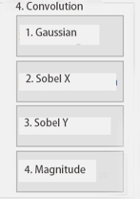
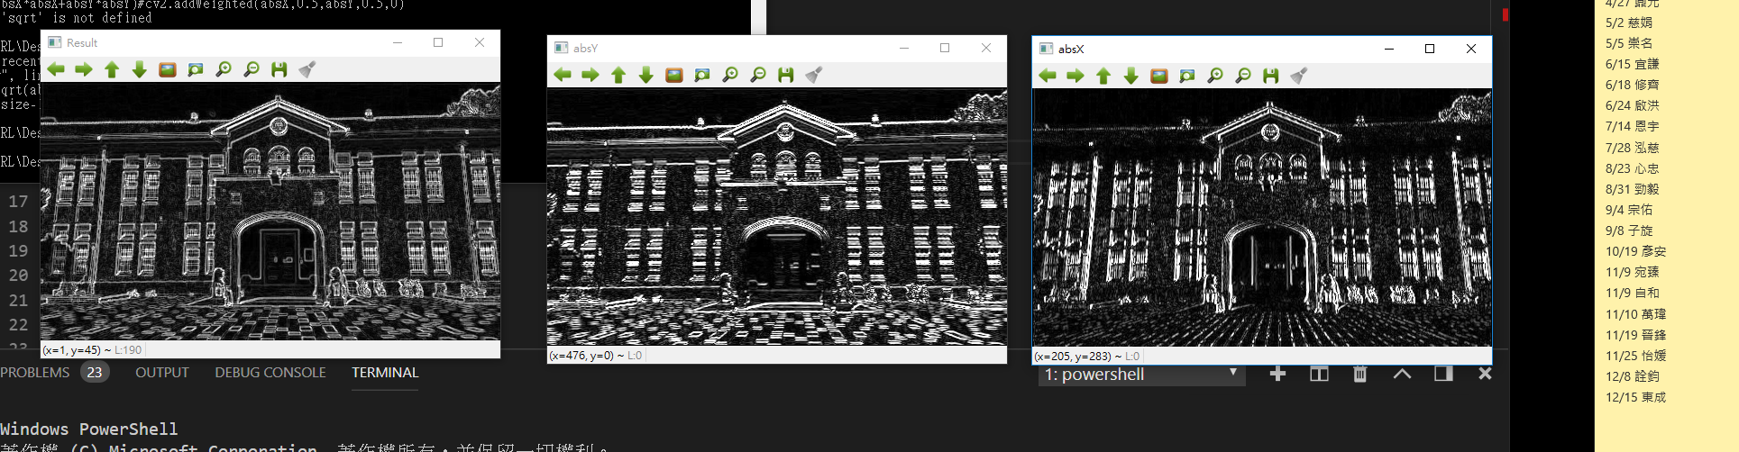
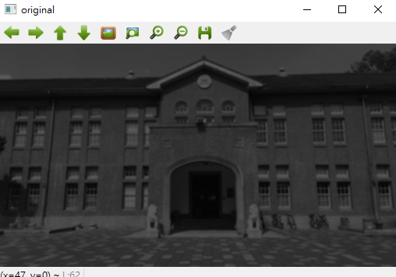
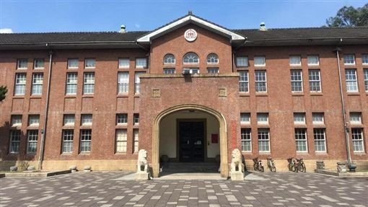
4. Edge Detection (出題：Kris)
Given: an RGB image, School.jpg
Q: 1) Convert the RGB image to grayscale image and then smooth the grayscale image by using your own 3x3 Gaussian smoothing filter and show the result. (5%)
(can not use OpenCV function)
2) Program and show the result using your own code - Sobel edge detection to detect horizontal edge (5%) and vertical (5%) edge. (can not use OpenCV function)
2.1) Normalize 2) result to 0~255 and show.
2.2) Use 2.1) result to calculate the magnitude and show.(5%)
Hint: Textbook Chapter 6, p.148 ~ 149
Hint: magnitude = || Sobel_x^{^2}+Sobel_y ^{^2}|| ^{1/2}
magnitude
vertical edges
School.jpg
3x3 Gaussian smooth filter
Horizontal edges
1

Slide 17
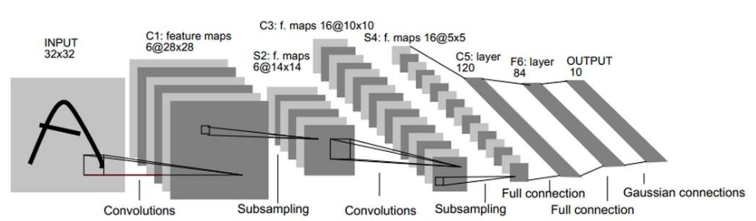
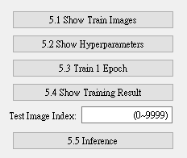
5.0 Training MNIST Classifier Using LeNet5 (出題：Charlie)
Learning to construct LeNet and training it on MNIST.
Environment Requirement
Python 3.7
Tensorflow 2.0 / PyTorch 1.3.0
opencv-contrib-python 3.4.2.17
Matplotlib 3.1.1
Reference
Gradient-Based Learning Applied to Document Recognition(http://yann.lecun.com/exdb/publis/pdf/lecun-01a.pdf) (LeNet)
MNIST (http://yann.lecun.com/exdb/mnist/)
1

Slide 18
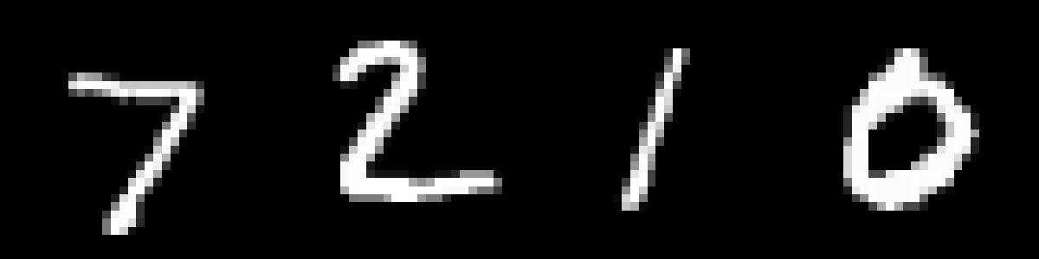
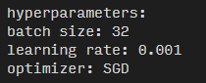
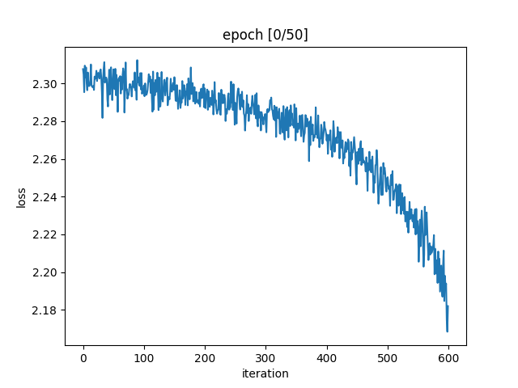
5.1 Load MNIST training dataset and randomly show 10 images and labels respectively. (10%)
5.2 Print out training hyperparameters (batch size, learning rate, optimizer). (10%)
5.3 Train 1 epoch from initial status and show training loss at the end of the epoch. (10%)
…
Label: 7 2 1 0 …
(record loss per iteration)

Slide 19
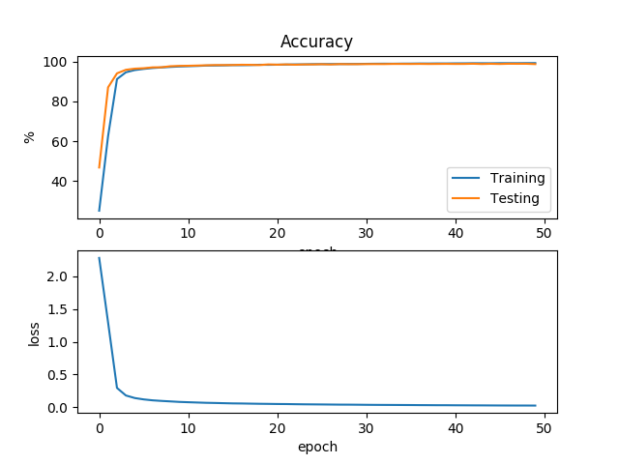
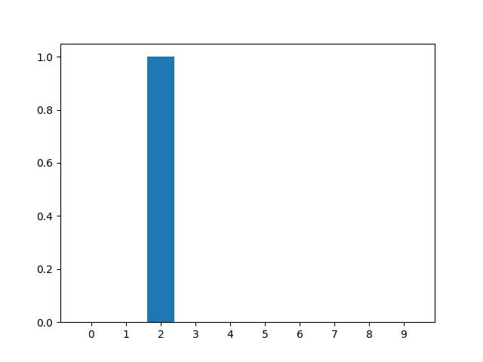

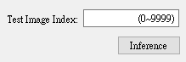
5.4 Training your model at least 50 epochs by your own computer, save your model and take a screenshot of your training loss and accuracy. (10%)
5.5 Load your model trained at 5.4, let us choose one image from MNIST test images, inference the image, show image and estimate the image as following. (10%)
(record accuracy/loss per epoch)

